Slide 1
1

Slide 2

APPLIED CRYPTOGRAPHY
Lecture 52
2

Slide 3
MAC
Message Authentication code
3

Slide 4
Contents
Encryption vs. Message Authentication
MAC definition
Working of MAC
The Syntax of a Message Authentication Code
Security experiment of Message Authentication Codes
Attacks and limitations

Slide 5
Encryption vs. Message Authentication
Encryption → secrecy and Authentication → integrity
Can encryption provide Message Authentication??
Stream ciphers: No
Block ciphers: yes with some modification

Slide 6
MAC definition:
is a short piece of information used to authenticate a message—in other words, to confirm that the message came from the stated sender (its authenticity) and has not been changed.
The aim of a message authentication code is to prevent an adversary from
modifying a message sent by one party to another, or from injecting a new
message, without the receiver detecting that the message did not originate
from the intended party.

Slide 8
The Syntax of a Message Authentication Code
t ← Mack(m)
compute a MAC tag (or simply a tag) t based on the message and the shared key (k),
send the message m and the tag t to the other party

Slide 9
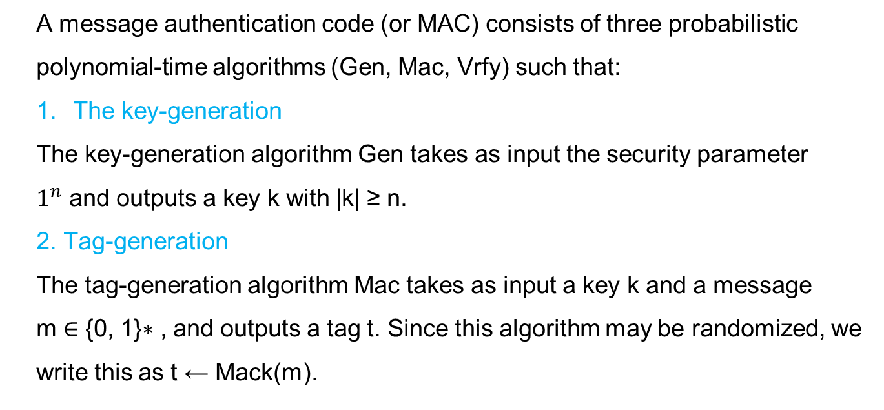
3 Polynomial algorithms
A message authentication code (or MAC) consists of three probabilistic polynomial-time algorithms (Gen, Mac, Vrfy) such that:
The key-generation
The key-generation algorithm Gen takes as input the security parameter
$1^{n}$ and outputs a key k with |k| ≥ n.
2. Tag-generation
The tag-generation algorithm Mac takes as input a key k and a message
m ∈ {0, 1}∗ , and outputs a tag t. Since this algorithm may be randomized, we write this as t ← Mack(m).

Slide 10
3. Verification
The deterministic verification algorithm Vrfy takes as input a key k, a
message m, and a tag t. It outputs a bit b, with b = 1 meaning valid and
b = 0 meaning invalid. We write this as b := Vrfyk(m, t).
It is required that for every n, every key k output by Gen(1^𝑛), and every m ∈ {0, 1}∗ , it holds that Vrfyk (m, Mack(m)) = 1.

Slide 11
Security of Message Authentication Codes
Experiment for a message authentication code ℿ
A MAC is secure if no efficient adversary can succeed in the above experiment with non-negligible probability:

Slide 12
A message authentication code Π = (Gen, Mac, Vrfy) is existentially unforgeable under an adaptive chosen-message attack, or just secure, if for all probabilistic polynomial-time adversaries A, there is a negligible function negl such that: Pr[Mac-forgeA,Π(n) = 1] ≤ negl(n).

Slide 13
Attacks
Reply attack
A potential timing attack

Slide 14
Limitations of MAC
Establishment of Shared Secret.
Inability to Provide Non-Repudiation

Slide 15
Thank You!
Next Class
Mandatory reading for the next class
RFC 6476
15

Slide 16


Rajashree S
Computer Science and Engineering
PES University, Bengaluru
10 June 2020
16

